Slide 1

Bangladesh Army University of Science and Technology (BAUST) Saidpur Cantonment
Department of Computer Science and Engineering (CSE)
Course Code : CSE 4140
Course Title : Machine Learning Sessional
Thesis Title : Impact of Childhood Activities on Adult Health Conditions: A Retrospective Study
Date : 1 June 2025
Presented By:
Member_1 : Md. Nihad Hossain ID : 210201023 Member _2 : Md Nur A Alam ID : 210201044
Course Teacher:
Teacher Name : Engr. Md. Mamun Hossain Designation : Associate Professor Teacher Name : Ashrafun Zannat Designation : Assistant Professor

Slide 2
Outline
Introduction
Objectives
Proposed Methodology
Dataset
Tasks & Models used
Key Observations
Feature Importance
Models Comparison
ROC Curve
Ensemble models
Results
Conclusion

Slide 3
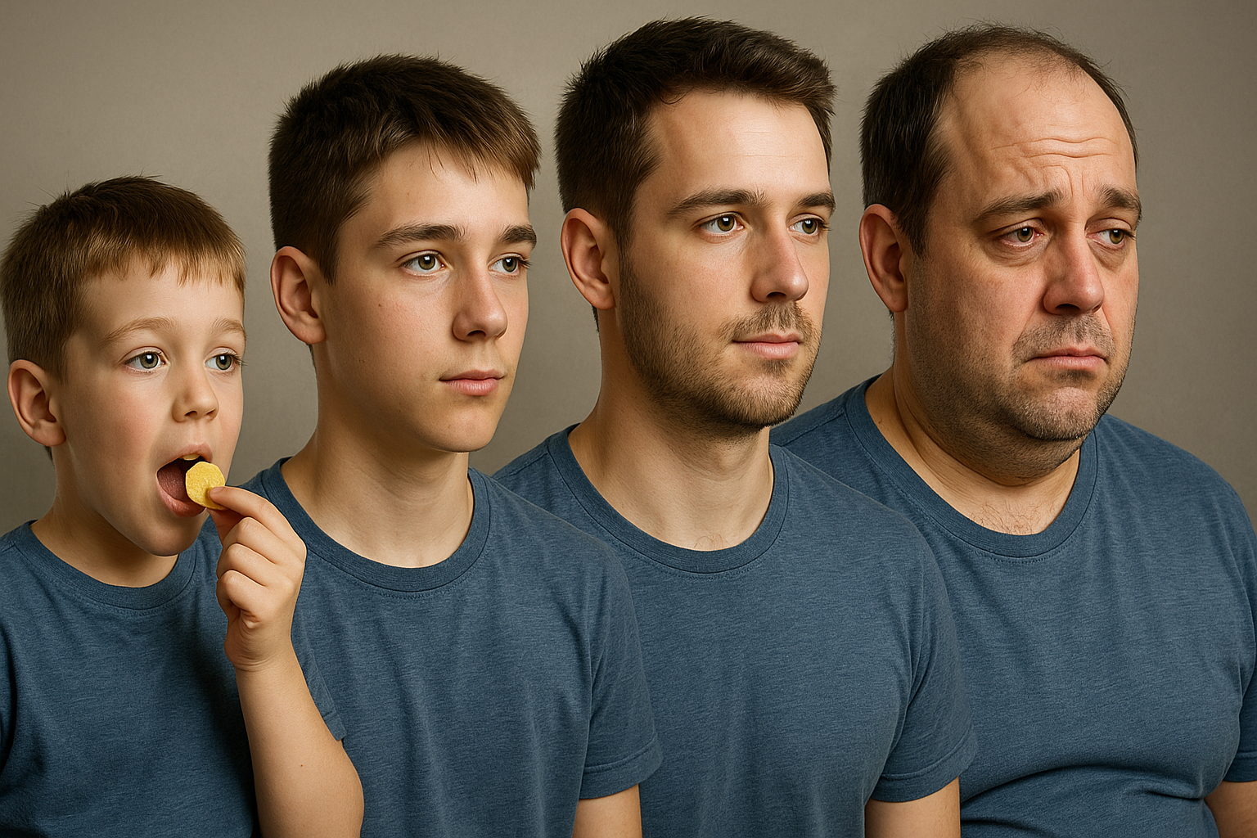
Introduction
Health Condition Dependencies: Adult health conditions such as depression, ADHD, sleep disorders, and postural issues often trace back to early-life behaviors..
Need for Insight: Identifying early risk factors enables prevention and personalized care.
ML in Health Research: Machine learning is effective in modeling long-term health patterns.
Study Focus: This study uses ML to predict adult health from childhood activity data.
Figure 1: Impact of Childhood behavior on Adult age

Slide 4
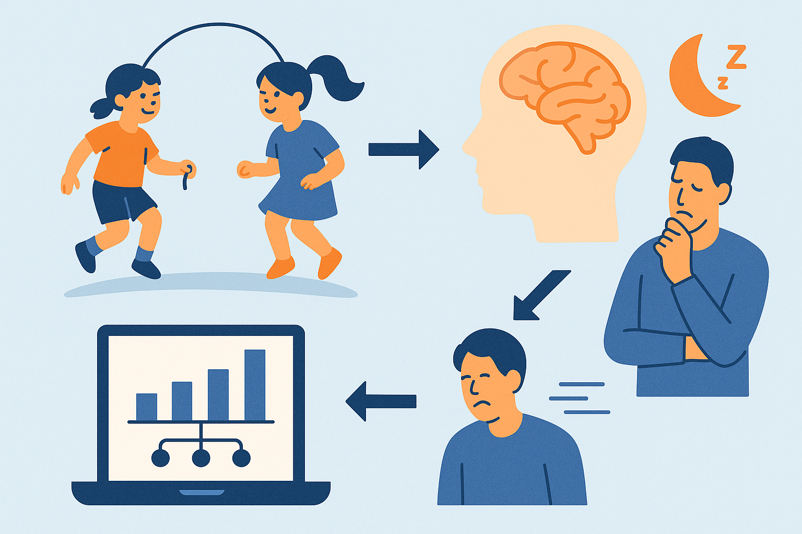
Objectives
Identify Associations: Examine links between childhood activities and adult health conditions.
Build & Train Predictive Models: Use machine learning (Random Forest & KNN) to predict adult outcomes.
Compare Model Performance: Evaluate and fine-tune models to select the most accurate predictor.
Support Early Intervention: Enable early health risk detection based on childhood behavior patterns.
Figure 2: Model taking I/O as input

Slide 5
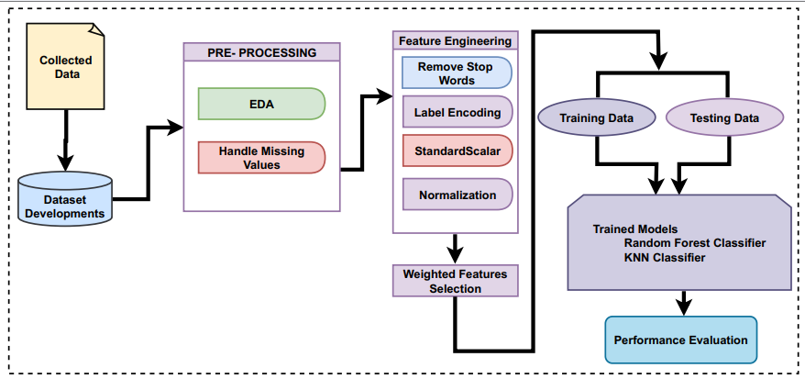
Proposed Methodology
Figure 3: Proposed Methodology

Slide 6
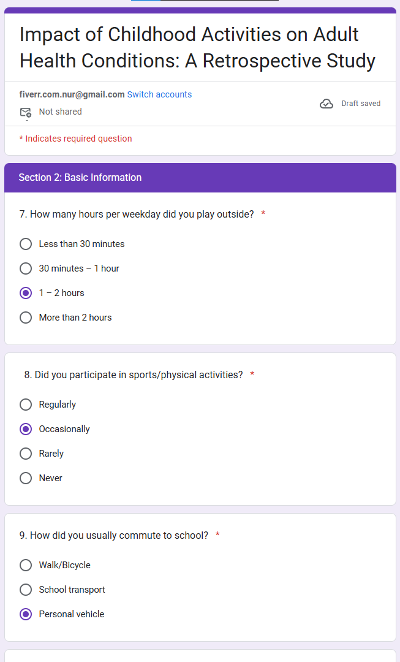
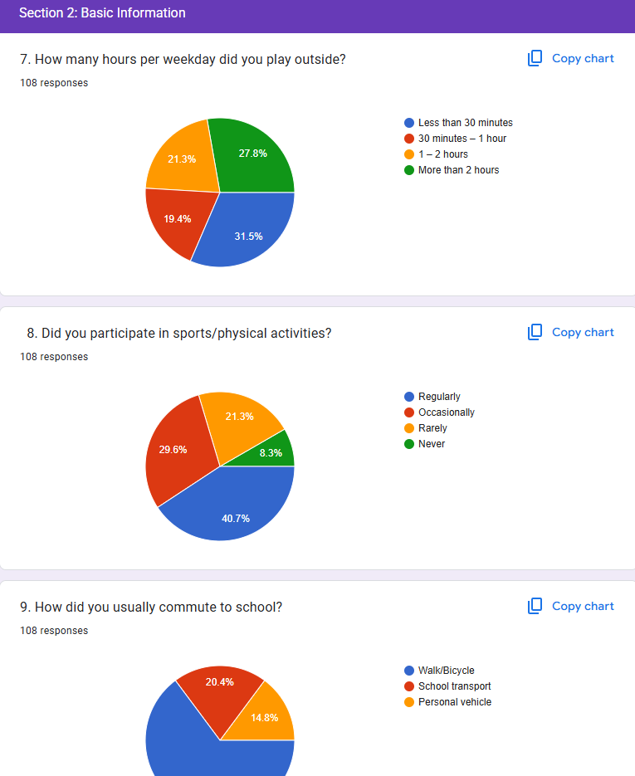
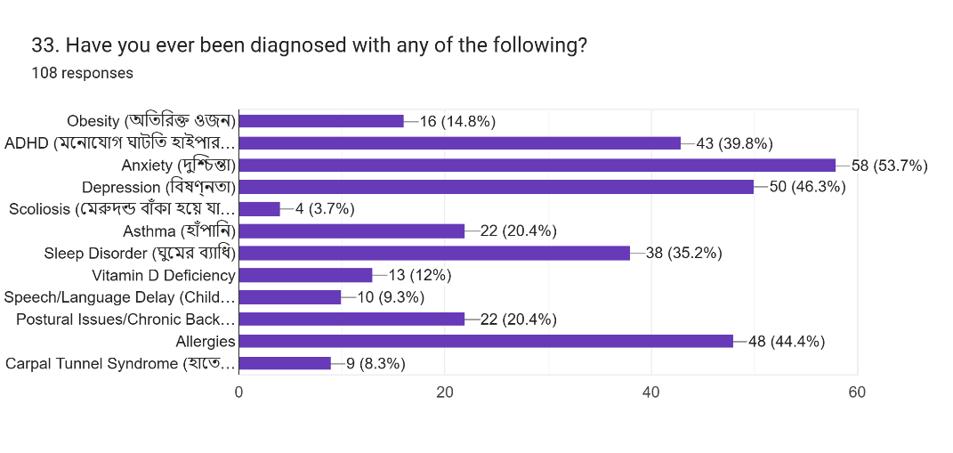
Dataset
Data Composition:
Target classes: 4 classes (ADHD, Depression, Sleep Disorder, Postural Issues)
Dimention: 25 X 506
Modality: Categorical and Numerical
Data Collection Plan:
Source: Our University + HSTU + DU + KU University Students
Method Used: Google forms
Storage Format: CSV, XLSX
Data counts: 506
Figure 4: Dataset Creation

Slide 7
Task & Models Used
Task:
EDA
Feature Engineering
Data Preprocessing
Apply ML models
Confusion Matrix
Performance Evaluation
Model Comparison
ROC Curve
Visualization of Importance Features
Ensemble Model Apply
Models Used:
K-Nearest Neighbors (KNN)
Random Forest
Support Vector Machine (SVM)
Table 1: Reason of choose model
Model | Reason for Use
K-Nearest Neighbors (KNN) | Simple and effective for tabular categorical data; good baseline for classification tasks.
Random Forest | Robust to overfitting handles categorical features well provides feature importance
Support Vector Machine (SVM) | Strong performance in high-dimensional spaces useful for binary classification.

Slide 8
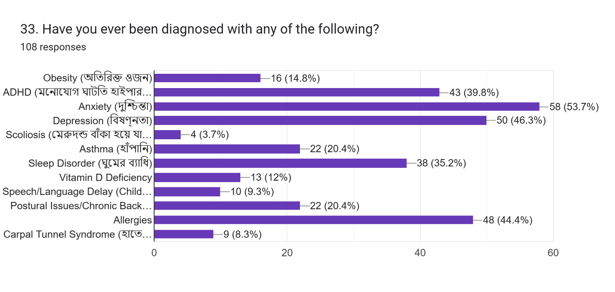
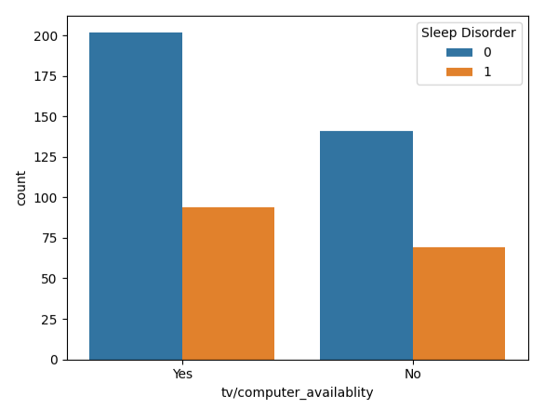
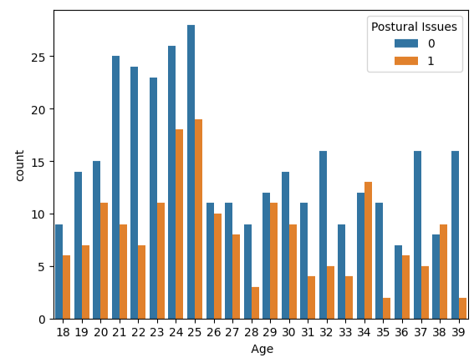
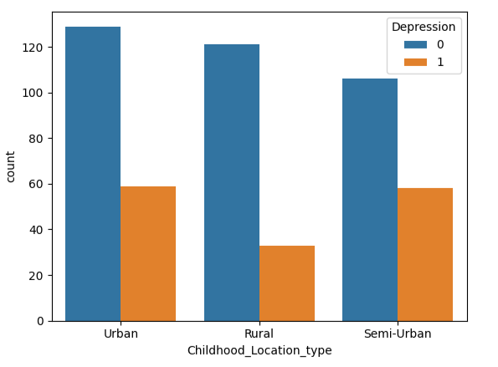
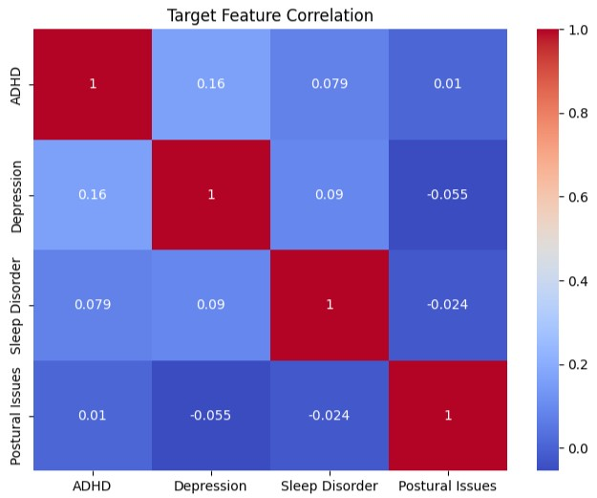
Key Observations
Choose: ADHD, Depression, Sleep Disorder, Postural Issues. TV/Computer availability = k * Sleep Disorder Age = k * Postural Issues Urban and Semi-Urban area people are mostly face Depression

Slide 9
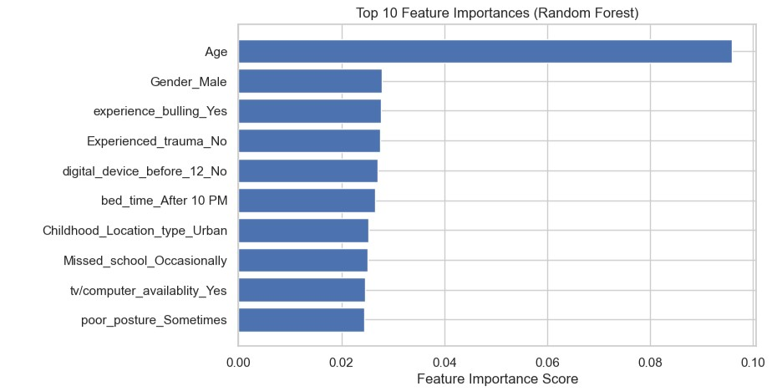
Feature Importance
Table 2: Importance features
Features | %
Age | 93%
Gender Male | 33%
Experience Bulling Yes | 32%
Experienced Trauma No | 31%
Digital Device before 12 No | 26%
Bed time after 10 pm | 25%
Childhood location Urban | 24%
Missed School Occasionally | 24%
Digital device availability yes | 23%
Poor posture sometimes | 23%
Figure 5: Top 10 most important features

Slide 10
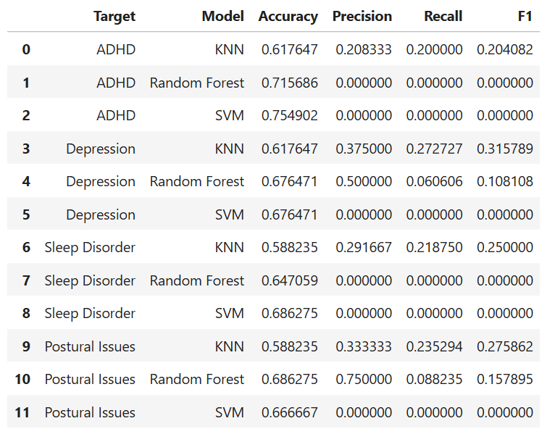
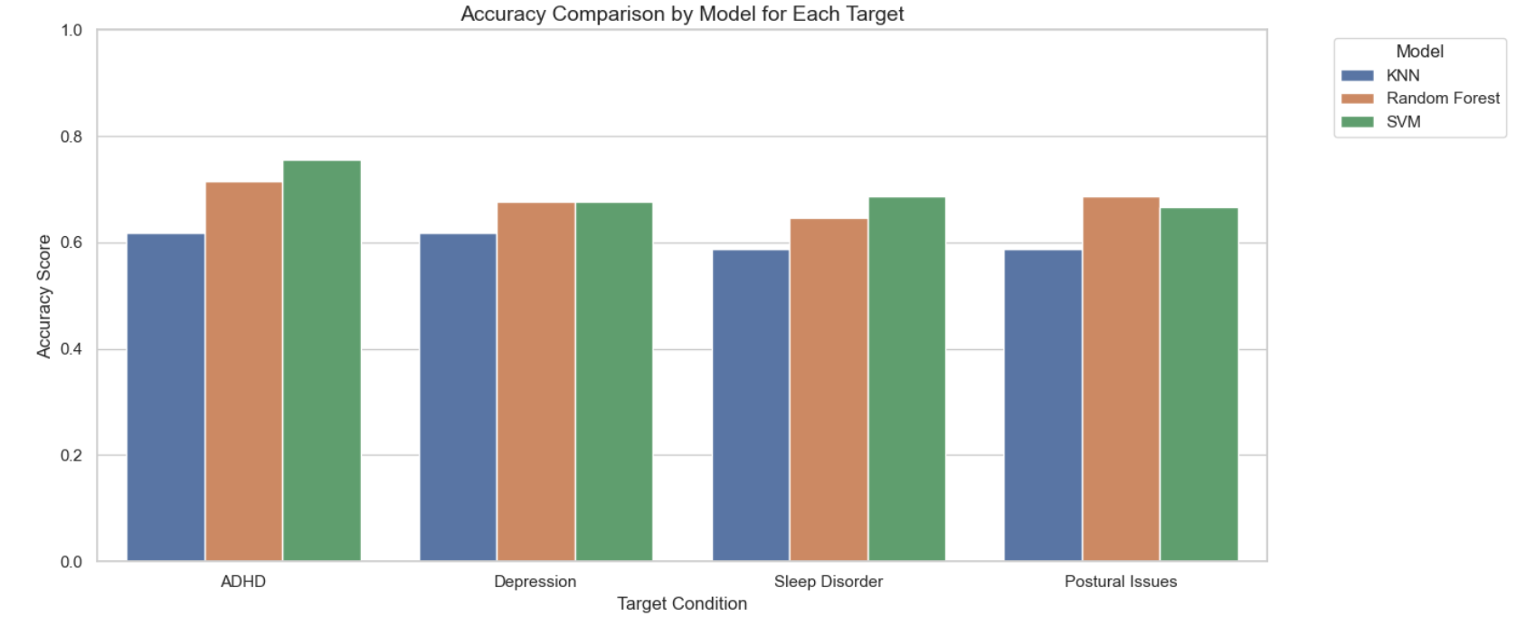
Models Comparison
Figure 6: Comparison of different models (RF, KNN, SVM)

Slide 11
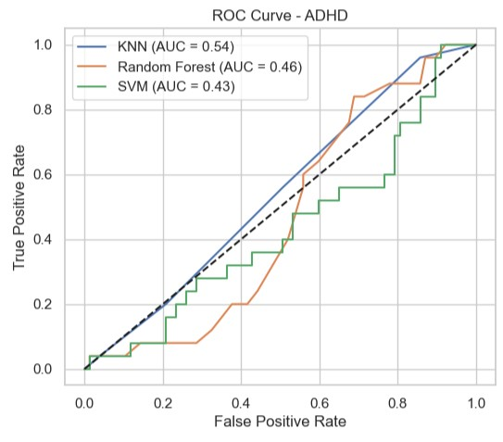
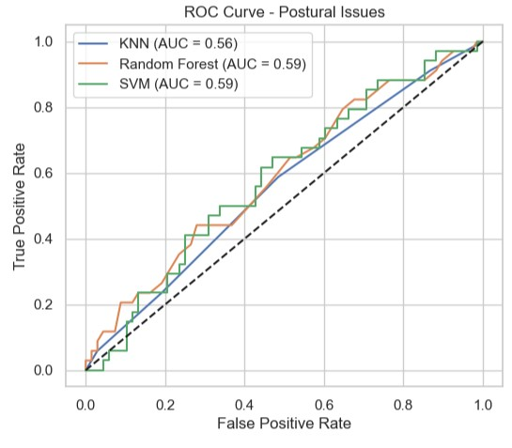
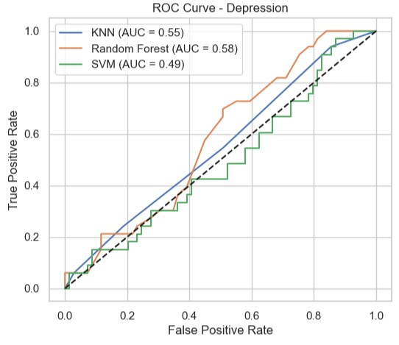
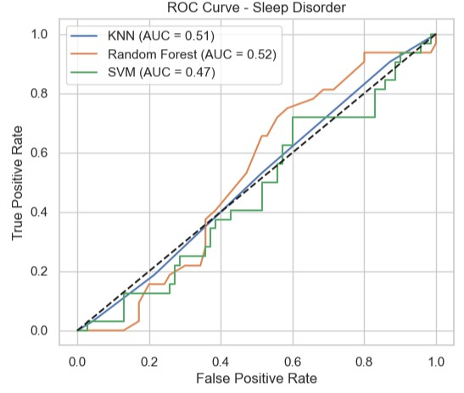
ROC Curve
Figure 7: ROC curve of ADHD and Depression

Slide 12
ROC Curve
Figure 8: ROC curve of Postural Issues and Sleep Disorder

Slide 13
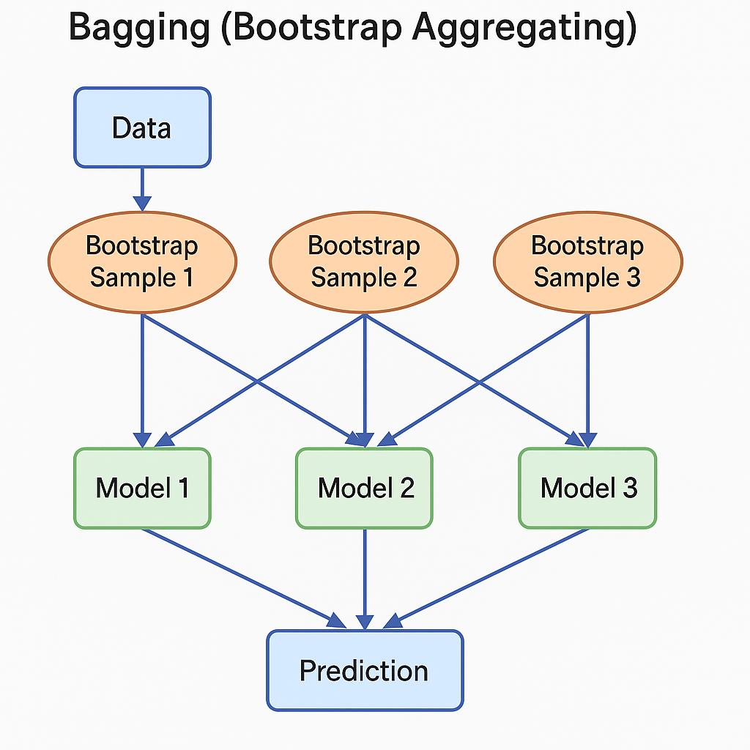
Ensemble models
Bagging (Bootstrap Aggregating):
Ensemble Model Used: BaggingClassifier
Base Estimator: RandomForestClassifier
How It Works: Multiple RandomForestClassifier models are trained on random subsets (bootstrapped samples) of the training data, and their predictions are averaged (or majority voted).
Purpose: Reduces variance and helps avoid overfitting.
Bagging Accuracy: 0.7549019607843137
Stacking Accuracy: 0.7549019607843137
Figure 9: Ensemble Model (Bagging) flow diagram

Slide 14
Results
Table 3: Average Metrics per Model
Table 4: Final Results Table
Model | Avg Accuracy | Avg Precision | Avg Recall | Avg F1
KNN | 0.6024 | 0.3021 | 0.2317 | 0.2615
Random Forest | 0.6815 | 0.3125 | 0.0372 | 0.0665
SVM | 0.6966 | 0.0000 | 0.0000 | 0.0000
Target | Best Model | Accuracy | Precision | Recall | F1 Score
ADHD | SVM | 0.7549 | 0.0000 | 0.0000 | 0.0000
Depression | KNN | 0.6176 | 0.3750 | 0.2727 | 0.3158
Sleep Disorder | SVM | 0.6863 | 0.0000 | 0.0000 | 0.0000
Postural Issues | Random Forest | 0.6863 | 0.7500 | 0.0882 | 0.1579
Table 4: Overall Averages (All Models Combined)
Metric | Value
Accuracy | 0.6600
Precision | 0.2049
Recall | 0.0896
F1 Score | 0.1093

Slide 15
Conclusion
This study demonstrates the effectiveness of machine learning in predicting adult health conditions from childhood activity data.
Analyzed data from 506 individuals (aged 18–40) to uncover behavioral patterns.
Applied Random Forest, SVM and KNN classifiers
Random Forest achieved up to 75% precision.
Highlights the predictive power of early-life behavior in determining future health outcomes.
Supports the role of ML in personalized and preventive healthcare.
Emphasizes the need for early detection and behavioral monitoring to ensure proactive health interventions.

Slide 16
Thank you all…

